Slide 1
Trauma Services Department
Trauma Assessment & Initial Management

Slide 2
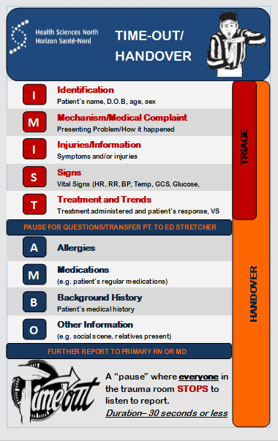
TRAUMA TIME OUT
Patient safety and the seamless transition of patient information has become a national concern.
“Prehospital communication is a critical first step towards ensuring efficient management of critically injured patients during trauma resuscitation.” Zhang et al. 2013.
Time Outs increase the amount of clinically RELEVANT patient information.
Time outs should not take any longer than 30 seconds

Slide 3
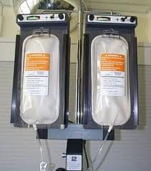
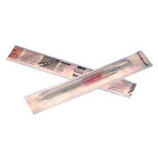
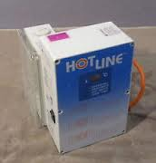
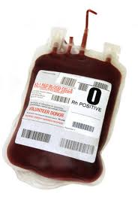
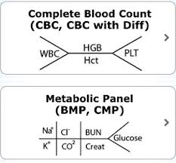
early goals in resuscitation →→→→→
Definitive airway
IV access x 2
- Warmed fluids
- Ability to infuse quickly
Avoid hypothermia
Assess & monitor perfusion
- Lactate and/or BE (Base Excess)
- Vital Signs
Control bleeding
Prepare for massive transfusion
- O-neg initially
- Order plasma & platelets
ATLS 10th Edition-American College of Surgeons
Notes:
Determine the need to intubate, warmed crystalloids (1 litres), warmed blood products.

Slide 4
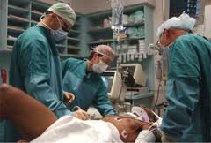
INITIAL ASSESSMENT
2 Phases:
Primary
Secondary
ATLS 10th Edition-American College of Surgeons

Slide 5
PRIMARY SURVEY
A --
Airway Maintenance with cervical spine precautions
Establish airway patency by talking to the patient
Foreign bodies?
Blood/secretions?
Facial fractures?
Laryngeal/tracheal fractures? (crepitus)
Swelling – hematoma or edema?
High C-spine injury (C3-C5)?
Inhalational injury – pulmonary damage?
Considerations:
B --
Breathing and Ventilation
Airway patency alone does not ensure adequate ventilation
Lungs, chest wall, and diaphragm need to function to provide
adequate ventilation and oxygenation. (ATLS 10th Edition)
Flail Chest?
Hemothorax?
Pneumothorax?
Tension?
Tamponade?
IMMEDIATE ED TREATMENTS
Tension pneumothorax – needle decompression
Open pneumothorax – occlusive dressing
Flail chest – intubate, ventilate
Massive hemothorax – chest tube
Considerations:
ATLS 10th Edition-American College of Surgeons
Notes:
Pt needs to have a definitive airway before moving on. Breathing must be survivable…if there are signs and symptoms of tension pneumo, hemo/pneumo, hemothorax insert a chest tube. For the tension pneumo perform a needle decompression followed by a chest tube insertion. C3,4,5, keep the diaphragm alive!

Slide 6
PRIMARY SURVEY
C - -
Circulation
Assessment of skin color and temperature, cap refill, pulse rate and character (thready, present or absent), level of consciousness?
Considerations:
External or internal hemorrhage?
Obstructive shock
D
- -
Disability
Baseline Neurological Evaluation:
GCS
Pupillary response and size
Extremity movement
Head injury?
Decreased cerebral oxygenation?
Alcohol consumption?
Drugs – Narcotics?
Hypoglycemia?
GCS <8
Intubate!
Considerations:
ATLS 10th Edition-American College of Surgeons
Notes:
The major areas of internal hemorrhage are the chest, abdomen, retroperitoneum, pelvis and long bones. Initiate 2 large bore IV’s and 1 L bolus of crystalloids warmed. If no positive response initiate blood products.

Slide 7
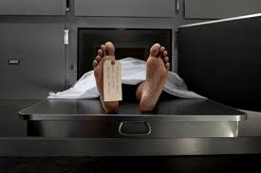
COAGULOPATHY IN TRAUMA
Pre-hospital
The trauma patient is quickly exposed to the elements and strapped to a hard wooden board.
Hospital Arrival
Patient is once again exposed in the ED,
bleeding is assessed. As the temperature of the trauma patient decreases the body’s ability to halt bleeding decreases.
Coagulopathy
Hypothermia =
Acidosis
= “DIC”
Disseminated Intravascular Coagulation
“DIC”- Death Is Coming
ATLS 10th Edition-American College of Surgeons
Notes:
Turn room temp up. Purchase underbody bair hugger blankets. Use warmed fluids and blood products. Cryo and FFP cannot be administered through a level one or fluid warmers.

Slide 8
PRIMARY SURVEY
E - -
Exposure and Environment
Remove all clothing. Patient can be hypothermic upon arrival after exposure to environment or may develop during resuscitation
Warm IV fluids?
Warm room?
Hemorrhage controlled?
Any further wounds posteriorly?
Considerations:
Adjuncts to Primary:
Monitoring equipment
Blood work
Arterial blood gases
Nasogastric tube/orogastric tube
Foley catheter to urometer (if not contraindicated)
Radiology/diagnostics
FAST (focused assessment sonography for trauma)
ATLS 10th Edition-American College of Surgeons
Notes:
A foley catheter is contraindicated for patients who may have a urethral injury (presence of blood at the urethral meatus or bruising of the perineum or scrotum)

Slide 9
SECONDARY SURVEY
H
- -
History/Head-to-Toe Assessment
Suspected Injuries (mechanism of injury)
Allergies
Medications Used
Past Medical History
Last Meal/LMP
Events/Environment Related to Injury
Head, shoulders, knees and toes
Complete a physical examination with inspection, auscultation and palpation. Some injuries can be expected when considering mechanism of injury, age, and biomechanics.
ATLS 10th Edition-American College of Surgeons
Notes:
SAMPLE. If ABC’s are in the safe zone this would be the time to gather more information from family, friends, EMS. Begin head to toe assessment by inspection, palpation, auscultation and identification.

Slide 10
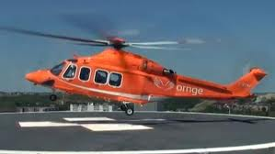
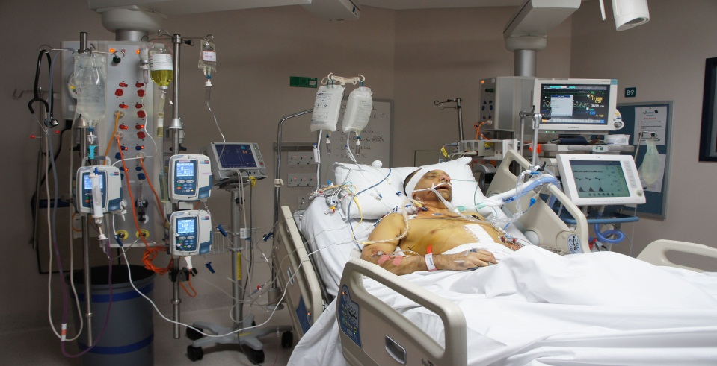
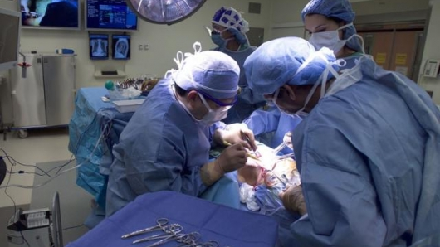
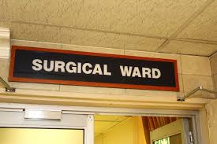
DEFINATIVE DISPOSTION
Notes:
Once the patient is stable in the primary survey the ED Physician or TTL needs to make a decision as to where the patient will be going next. Consultations will be determined by this decision. Does the patient need a higher level of care? Sunnybrook, St. Mike’s? If staying at HSN will the patient need to go directly to the OR for life saving interventions? Do not delay transfer to the OR for imaging. If the patient is to be air lifted out continue with interventions until air shows up. Will the patient need to go to the ICU – consult and visit from the Intensivist. Surgical consultations will result if the patient is stable enough to simply go to a surgical ward.

Slide 11
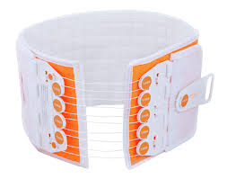
PELVIC STABILIZATION
T-POD (Trauma Pelvic Orthotic Device)
Reduces pelvic volume/tamponades bleeding
Prevents additional damage to veins and arteries in the area of the fracture
Prevents additional damage to nerves in the area of the fracture
Prevents additional movement of the bones near the fracture site
Reduces pain
www.pyng.com (e-book)

Slide 12
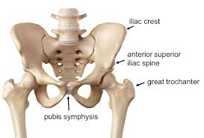
Considerations:
100% radiolucent.
One time use.
One size fits all (including children ≥ 50 lbs.).
If not contraindicated, a foley catheter should be placed prior to application if needed.
Injuries to the bladder, urethra, prostate, uterus, vagina, and anal canal can also be present.
Skin checks should be done every 12 hrs.
Monitor neurovascular status prior to and after application.
Center over greater trochanters.
www.pyng.com (e-book)
ATLS 10th Edition-American College of Surgeons

Slide 13
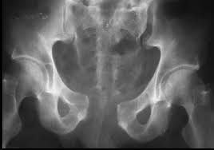
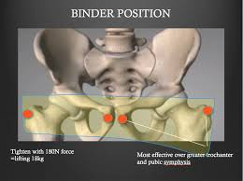
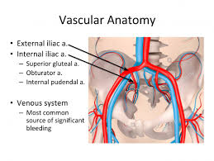
Open book pelvic #

Slide 14
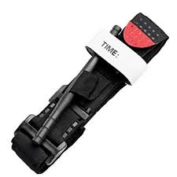
TOURNIQUET USE AND CARE
Indications for use:
Amputation (partial or total)
Crushed or mangled extremity
Penetrating injury (lacerations, gunshot, stabbing)
Open fracture with uncontrolled bleeding
Considerations:
The first step is to apply direct pressure to the wound. For large wounds pack gauze tightly into the wound until bleeding stops and hold pressure.
If bleeding continues or if direct pressure/packing is not attainable apply a tourniquet.
ALWAYS provide pain medication to the patient.
www.bleedingcontrol.org

Slide 15
SIMULATION SCENARIOS
1. A 21 year old male who sustained multiple stab wounds outside a night club tonight:
Weapon was a 3 inch hunting knife
Patient is conscious but very anxious
Vital signs – BP 100/60, HR 100, RR 26, has a NRB on
EMS identified 3 stab wounds to chest and abdomen
Small amount of blood at the scene
EMS has a 20g. IV with ringers lactate infusing as a bolus
2. A 56 year old male involved in a motorcycle crash on a busy street. Car forced him off the road and he was thrown into a ditch. He was wearing a helmet. EMS (BLS) crew scooped and ran:
Arrival vital signs – BP 75/55, HR 100, RR 20, SpO₂ 100% on NRB
C-spine collar and back board
Patient is talking

Slide 16
SIMULATION SCENARIOS
A 27 year old male was swimming and was struck by a motorboat:
He has a LARGE laceration to the back of his head and his right thigh
He has swallowed lots of water
Vital signs – BP 130/90, HR 125, RR 26, SpO₂ 87% with NRB, T 35.8

Slide 17
References
American College of Surgeons (2018). Advanced Trauma Life Support, Student course Manual 10th Edition.
Pyng Medical (2019). T-PODResponder Pelvic Stabilization Device. Retrieved from http://www.pyng.com
https://youtu.be/NlYt4rO1B8k
http://www.pyng.com/products/t-podresponder/t-podresponder-training/

